Slide 1
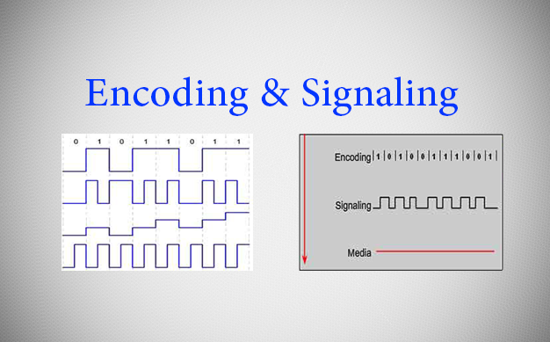
Encoding and Signaling
Encoding: Encoding is a method of converting a stream of data bits into a predefined code. Codes are groupings of bits used to provide a predictable pattern that can be recognized by both the sender and the received. Using predictable patterns helps to distinguish data bits from control bits and provide better media error detection.
Signaling: The method of representing the bits is called the signaling method, The Physical layer must generate the electrical, optical, or wireless signals that represent the “1” and “0” on the media.

Slide 2
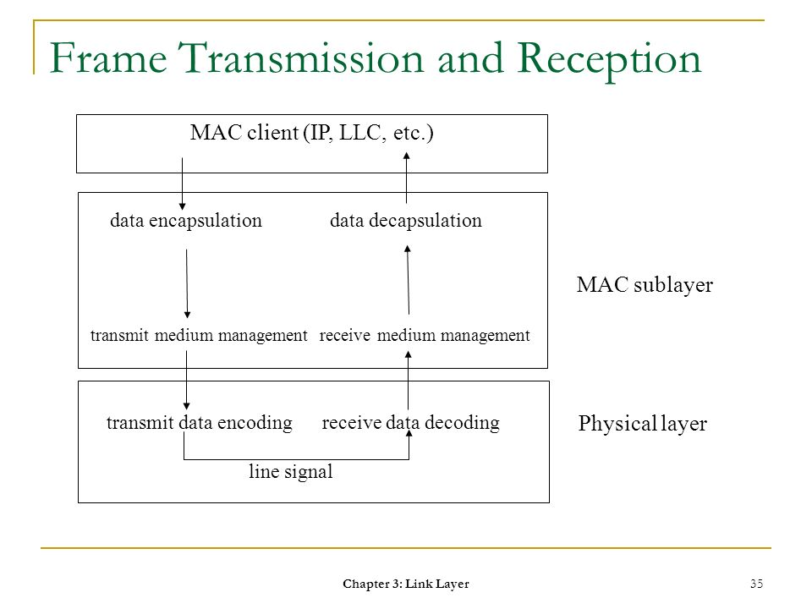
Data Transmission and Reception
The transfer of each bit of data is the responsibility of this layer. This layer assures the transmission of each bit with a high probability. The transmission of the bits is not completely reliable as their is no error correction in this layer.

Slide 3
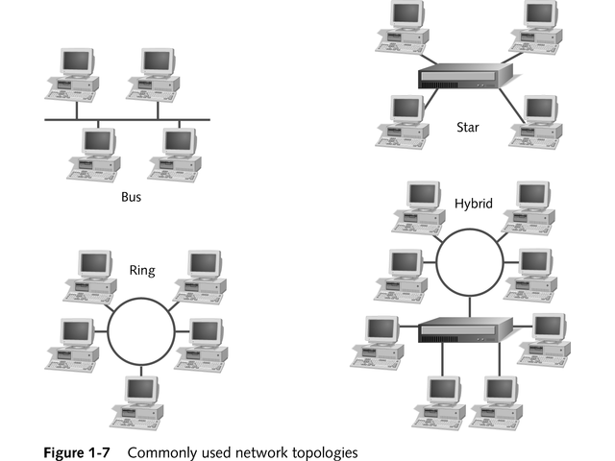
Topology and Network Design
The network design is the integral part of the physical layer. Which part of the network is the router going to be placed, where the switches will be used, where we will put the hubs, how many machines is each switch going to handle, what server is going to be placed where, and many such concerns are to be taken care of by the physical layer. The various kinds of netopologies that we decide to use may be ring, bus, star or a hybrid of these topologies depending on our requirements.

